Slide 1

Advanced Probabilistic Machine Learning
Ralf Herbrich, Rainer Schlosser
Approximate Inference: Expectation Propagation

Slide 2
Overview
Distance Measures for Distributions
Approximating Marginals: Expectation Propagation
Approximating Normalization Constants
Application: Bayesian Ranking

Slide 3
Overview
Distance Measures for Distributions
Approximating Marginals: Expectation Propagation
Approximating Normalization Constants
Application: Bayesian Ranking

Slide 4
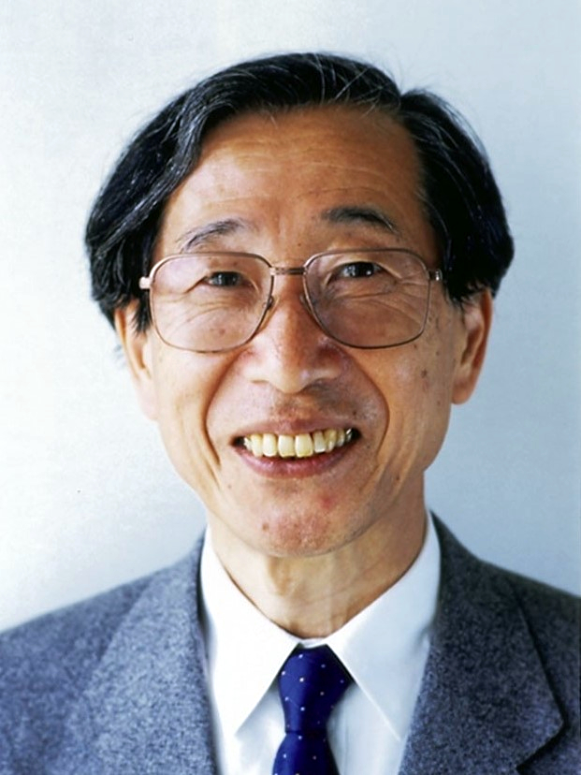
Distance Measures: $α$-Divergence
Problem. We have a non-Gaussian normalized marginal $p(⋅)$ and would like to approximate it by a Gaussian $q\left(⋅\right)=𝒩\left(⋅;μ,σ^{2}\right)$. What is the optimal approximation?
Solution. To define “optimality”, we need a distance measure between probability densities $p\left(⋅\right)$ and $q\left(⋅\right)$!
$α$-Divergence (Amari, 1985). Given two probability densities $p\left(⋅\right)$ and $q\left(⋅\right)$ and $α∈ℝ∖\left\{0,1\right\}$ the $α$-divergence $D_{α}\left[p,q\right]$ is defined by
$$D_{α}\left[p,q\right]=\frac{1}{α\left(1−α\right)}⋅\left(1−\int_{−∞}^{+∞}{{\left[\frac{p\left(x\right)}{q\left(x\right)}\right]}^{α}⋅q\left(x\right) dx}\right)$$
Non-Negativity: If $p=q$ then $D_{α}\left[p,q\right]=0$; otherwise $D_{α}\left[p,q\right]>0$
Asymmetry: $D_{α}\left[p,q\right]≠D_{α}\left[q,p\right]$
Flexibility:
$α>1$ gives more weight to regions where $p\left(x\right)>q\left(x\right)$
$α<1$ gives more weight to regions where $q\left(x\right)>p\left(x\right)$
Shun'ichi Amari (甘利 俊) (1936)
Expectation of ${\left[\frac{p\left(x\right)}{q\left(x\right)}\right]}^{α}$ over $q\left(x\right)$
If $p=q$ then ${\left[\frac{p\left(x\right)}{q\left(x\right)}\right]}^{α}=1$ and the expectation is $1$

Slide 5
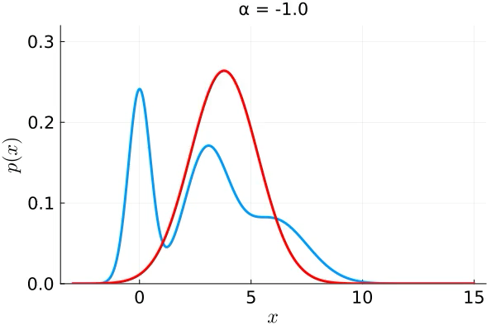
$α$-Divergence with a Gaussian in Pictures
zero-forcing & mode seeking
inclusive & support seeking
$$α$$
$$α=−∞$$
$$α=−1$$
$$α=0$$
$$α=1$$
$$α=+∞$$

Slide 6
$α$-Divergence with a Gaussian and Moment Matching
Only for $α=1$ both the first and second moment (that is, mean and variance) are matched with that of the approximation!
The case $α=1$ is a limit case.

Slide 7

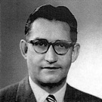
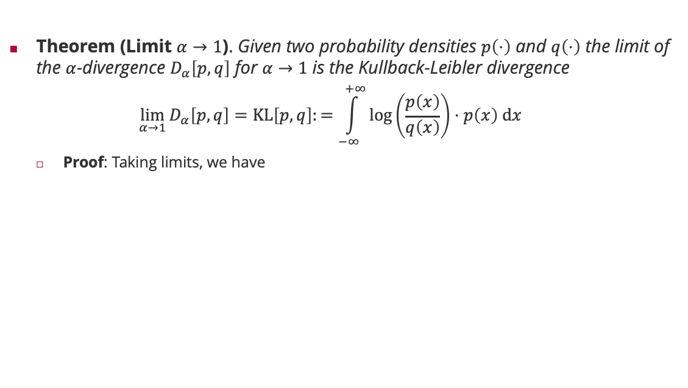
$α=1$: KL Divergence
Theorem (Limit $α→1$). Given two probability densities $p\left(⋅\right)$ and $q\left(⋅\right)$ the limit of the $α$-divergence $D_{α}\left[p,q\right]$ for $α→1$ is the Kullback-Leibler divergence
$$\lim_{α→1}{D_{α}\left[p,q\right]}=KL\left[p,q\right]:=\int_{−∞}^{+∞}{\log\left(\frac{p\left(x\right)}{q\left(x\right)}\right)⋅p\left(x\right) dx}$$
Proof: Taking limits, we have
Solomon Kullback (1909 – 1994)
$$\lim_{α→1}{D_{α}\left[p,q\right]}=\lim_{α→1}{\frac{1}{α\left(1−α\right)}⋅\left(1−\int_{−∞}^{+∞}{{\left[\frac{p\left(x\right)}{q\left(x\right)}\right]}^{α}⋅q\left(x\right) dx}\right)}$$
L'Hôpital's rule!
Note that $\frac{d}{dz} b^{z}=\log\left(b\right)⋅b^{z}$
$$=\lim_{α→1}{\frac{1}{1−2α}⋅\left(−\int_{−∞}^{+∞}{{\log\left(\frac{p\left(x\right)}{q\left(x\right)}\right)⋅\left[\frac{p\left(x\right)}{q\left(x\right)}\right]}^{α}⋅q\left(x\right) dx}\right)}$$
Richard Leibler (1914 – 2003)
$$=\int_{−∞}^{+∞}{\log\left(\frac{p\left(x\right)}{q\left(x\right)}\right)⋅p\left(x\right) dx}$$

Slide 8
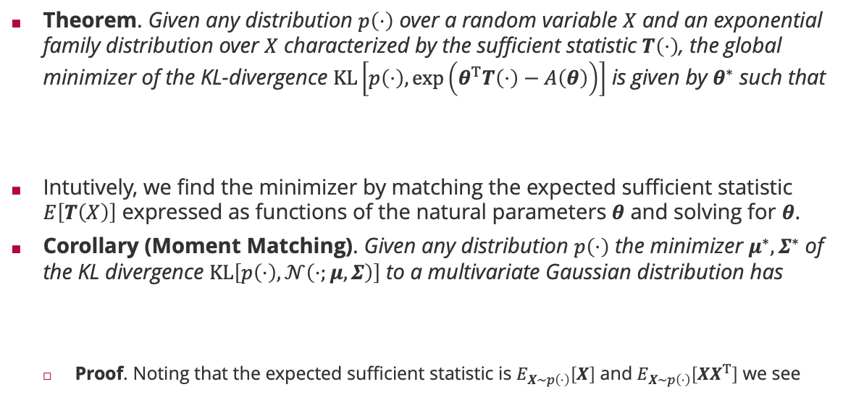


Minimizing the KL Divergence
Theorem. Given any distribution $p\left(⋅\right)$ over a random variable $X$ and an exponential family distribution over $X$ characterized by the sufficient statistic $T\left(⋅\right)$, the global minimizer of the KL-divergence $KL\left[p\left(⋅\right),\exp\left(θ^{T}T\left(⋅\right)−A\left(θ\right)\right)\right]$ is given by $θ^{∗}$ such that
Intutively, we find the minimizer by matching the expected sufficient statistic $E\left[T\left(X\right)\right]$ expressed as functions of the natural parameters $θ$ and solving for $θ$.
Corollary (Moment Matching). Given any distribution $p\left(⋅\right)$ the minimizer $μ^{∗},Σ^{∗}$ of the KL divergence $KL\left[p\left(⋅\right),𝒩\left(⋅;μ,Σ\right)\right]$ to a multivariate Gaussian distribution has
Proof. Noting that the expected sufficient statistic is $E_{X∼p\left(⋅\right)}\left[X\right]$ and $E_{X∼p\left(⋅\right)}\left[XX^{T}\right]$ we see
$$E_{X∼\exp\left(θ^{T}T\left(⋅\right)−A\left(θ\right)\right)}\left[T\left(X\right)\right]=E_{X∼p\left(⋅\right)}\left[T\left(X\right)\right]$$
$$μ^{∗}=E_{X∼p\left(⋅\right)}\left[X\right] and Σ^{∗}=E_{X∼p\left(⋅\right)}\left[\left(X−μ^{∗}\right){\left(X−μ^{∗}\right)}^{T}\right]$$
$$μ^{∗}=E_{X∼p\left(⋅\right)}\left[X\right]$$
$$Σ^{∗}=E_{X∼p\left(⋅\right)}\left[XX^{T}\right]−\left(E_{X∼p\left(⋅\right)}\left[X\right]\right){\left(E_{X∼p\left(⋅\right)}\left[X\right]\right)}^{T}$$

Slide 9
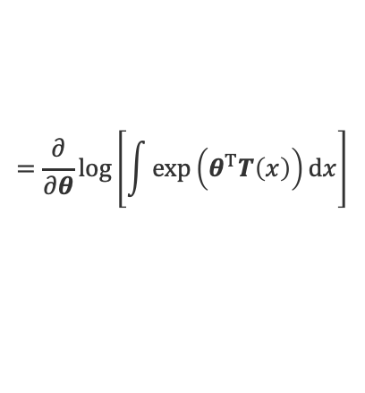






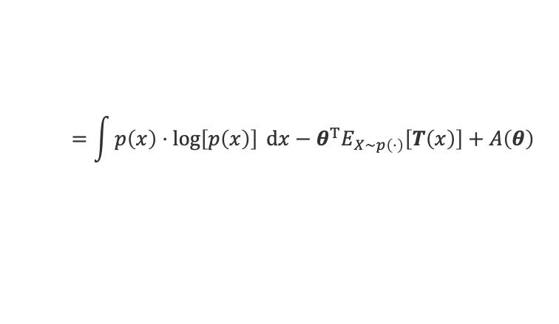
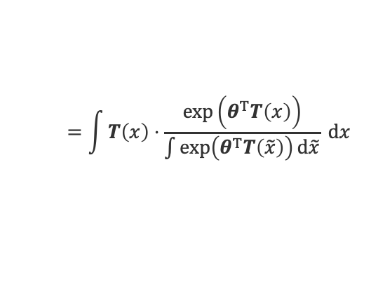
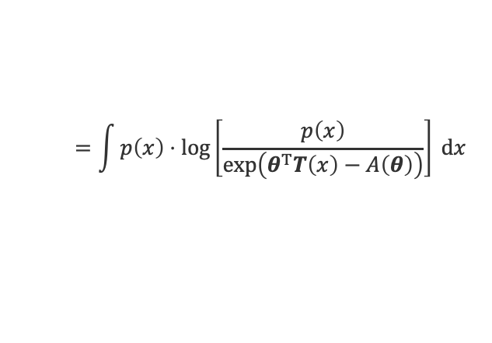
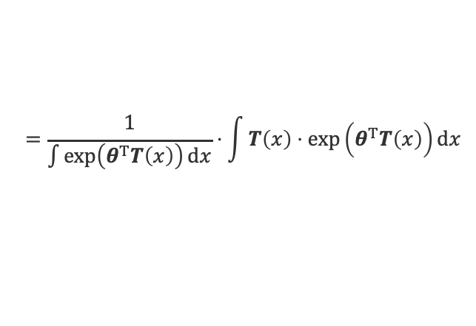
Proof of KL Divergence Minimizer
Let us write the KL divergence as a function of the natural parameters $θ$
Taking the derivative of the KL divergence w.r.t. $θ$ and setting this to $0$
Taking the derivative of the log-normalization constant
$$=\int{p\left(x\right)⋅\log\left[\frac{p\left(x\right)}{\exp\left(θ^{T}T\left(x\right)−A\left(θ\right)\right)}\right] dx}$$
Linearity of expectation
$$KL\left[p\left(⋅\right),\exp\left(θ^{T}T\left(⋅\right)−A\left(θ\right)\right)\right]$$
$$=\int{p\left(x\right)⋅\log\left[p\left(x\right)\right] dx}−θ^{T}E_{X∼p\left(⋅\right)}\left[T\left(x\right)\right]+A\left(θ\right)$$
Independent of $x$
$$\frac{∂}{∂θ}A\left(θ^{∗}\right)=E_{X∼p\left(⋅\right)}\left[T\left(x\right)\right]$$
$$\frac{∂}{∂θ}A\left(θ^{∗}\right)$$
$$=\frac{∂}{∂θ}\log\left[\int{\exp\left(θ^{T}T\left(x\right)\right)dx}\right]$$
$$=\frac{1}{\int{\exp\left(θ^{T}T\left(x\right)\right)dx}}⋅\int{T\left(x\right)⋅\exp\left(θ^{T}T\left(x\right)\right)dx}$$
$$=\int{T\left(x\right)⋅\frac{\exp\left(θ^{T}T\left(x\right)\right)}{\int{\exp\left(θ^{T}T\left(\tilde{x}\right)\right)d\tilde{x}}} dx}$$
$$=E_{X∼\exp\left(θ^{T}T\left(⋅\right)−A\left(θ\right)\right)}\left[T\left(X\right)\right]$$

Slide 10
Overview
Distance Measures for Distributions
Approximating Marginals: Expectation Propagation
Approximating Normalization Constants
Application: Bayesian Ranking

Slide 11
Sum-Product Algorithm Revisited
The key operation for factor $f\left(x_{1},x_{2},…,x_{n}\right)$ and variable $X_{1}$is
Based on outgoing messages, we can compute both non-normalized marginals $p_{X}\left(⋅\right)$ and $m_{X→f}\left(⋅\right)$
Idea:
We approximate all outgoing messages $m_{f→X}\left(⋅\right)$ by a Gaussian ${\hat{m}}_{f→X}\left(⋅\right)=𝒩\left(⋅;μ,σ^{2}\right)$
We measure the approximation quality in the normalized marginal, not the outgoing message
$$m_{f→X_{1}}\left(x_{1}\right)=\sum_{\left\{x_{2}\right\}}{⋯\sum_{\left\{x_{n}\right\}}{f\left(x_{1},x_{2},…,x_{n}\right)\prod_{j=2}^{n}{m_{X_{j}→f}\left(x_{j}\right)}}}$$
If all $m_{X_{j}→f}\left(x_{j}\right)$are Gaussian, the result might not be Gaussian!
$$p_{X}\left(x\right)=\prod_{f∈ne\left(X\right)}{m_{f→X}\left(x\right)}$$
$$m_{X→f}\left(x\right)=\frac{p_{X}\left(x\right)}{m_{f→X}\left(x\right)}$$
If all $m_{X_{j}→f}\left(x_{j}\right)$are Gaussian, the result must be Gaussian!
$$\hat{p}\left(⋅\right)=\arg{\min_{μ,σ^{2}}{KL\left[\frac{m_{f→X}\left(⋅\right)⋅{\hat{m}}_{X→f}\left(⋅\right)}{\int_{−∞}^{+∞}{m_{f→X}\left(\tilde{x}\right)⋅{\hat{m}}_{X→f}\left(\tilde{x}\right) d\tilde{x}}}, \frac{{𝒩\left(⋅;μ,σ^{2}\right)⋅\hat{m}}_{X→f}\left(⋅\right)}{\int_{−∞}^{+∞}{{𝒩\left(\tilde{x};μ,σ^{2}\right)⋅\hat{m}}_{X→f}\left(\tilde{x}\right) d\tilde{x}}}\right]}}$$
True normalized marginal with approximate incoming message
Approximate marginal with approximate incoming message

Slide 12
Approximate Message Passing: Example
$$f\left(x\right)=𝕀\left(x>0\right)$$
$${\hat{m}}_{X→f}\left(x\right)∝\frac{{\hat{p}}_{X}\left(x\right)}{{\hat{m}}_{f→X}\left(x\right)}$$
$${\hat{m}}_{f→X}\left(x\right)∝\frac{{\hat{p}}_{X}\left(x\right)}{{\hat{m}}_{X→f}\left(x\right)}$$
$$p_{X}\left(x\right)∝f\left(x\right)⋅{\hat{m}}_{X→f}\left(x\right)$$
$${\hat{p}}_{X}\left(x\right)=𝒩\left(x;E_{X∼p_{X}}\left[X\right],{var}_{X∼p_{X}}\left[X\right] \right)$$

Slide 13

Expectation Propagation
Idea: If we have factors in the factor graph that require approximate messages, we keep iterating on the whole path between them until convergence minimizing $KL\left(p\left(⋅\right)|𝒩\left(⋅;μ,σ^{2}\right)\right)$ locally for the affected marginals of the approximate factor.
Theorem (Minka, 2003): The approximate message passing algorithm using the Kullback-Leibler convergence will always converge if the approximating distribution is in the exponential family!
Tom Minka
1
1
1
$$X_{1}$$
$$X_{2}$$
$$X_{5}$$
8
4
7
8
2
5
$$X_{3}$$
$$X_{4}$$
3
6
iterate until convergence

Slide 14
Doubly-Truncated Gaussians
Doubly-Truncated Gaussian. Given $l,u∈ℝ$, $μ∈ℝ$ and $σ^{2}∈ℝ^{+}$, a random variable $X$ has a doubly-truncated Gaussian distribution if
Moments of Doubly-Truncated Gaussian. Given a random variable $X$ that has a doubly-truncated Gaussian distribution and $t_{a}≔a/σ$, we know
$$p_{X}\left(x\right)∝𝕀\left(l<x<u\right)⋅𝒩\left(x;μ,σ^{2}\right)$$
$$Φ\left(z\right)≔ \int_{−∞}^{z}{𝒩\left(x;0,1\right) dx}$$
$$E\left[X^{0}\right]=Φ\left(t_{u−μ}\right)−Φ\left(t_{l−μ}\right)$$
$$E\left[X^{1}\right]=μ+σ⋅\frac{𝒩\left(t_{l−μ}\right)−𝒩\left(t_{u−μ}\right)}{Φ\left(t_{u−μ}\right)−Φ\left(t_{l−μ}\right)}$$
Additive correction that goes to zero as $u→∞$ and $l→−∞$
$$E\left[X^{2}\right]=μ^{2}+σ^{2}⋅\left[1−\frac{t_{u+μ}⋅𝒩\left(t_{u−μ}\right)−t_{l+μ}⋅𝒩\left(t_{l−μ}\right)}{Φ\left(t_{u−μ}\right)−Φ\left(t_{l−μ}\right)}\right]$$
Multiplicative correction that goes to one as $u→∞$ and $l→−∞$

Slide 15
Doubly-Truncated Gaussians (ctd)
Using the variance decomposition theorem we see
$$E\left[X\right]=μ+σ⋅v_{\frac{l}{σ},\frac{u}{σ}}\left(\frac{μ}{σ}\right)$$
$$var\left[X\right]=σ^{2}⋅\left[1−w_{\frac{l}{σ},\frac{u}{σ}}\left(\frac{μ}{σ}\right)\right]$$
$$v_{l,u}\left(z\right):=\frac{𝒩\left(l−z\right)−𝒩\left(u−z\right)}{Φ\left(u−z\right)−Φ\left(l−z\right)}$$
$$w_{l,u}\left(z\right):=\frac{\left(u+z\right)⋅𝒩\left(u−z\right)−\left(l+z\right)⋅𝒩\left(l−z\right)}{Φ\left(u−z\right)−Φ\left(l−z\right)}+v_{l,u}\left(z\right)⋅\left[2z+v_{l,u}\left(z\right)\right]$$
$$x<0$$
$$−5≤x<0$$
$$−3≤x<3$$
$$0≤x$$
$$v(t)$$
$$w(t)$$

Slide 16
Overview
Distance Measures for Distributions
Approximating Marginals: Expectation Propagation
Approximating Normalization Constants
Application: Bayesian Ranking

Slide 17
Normalization Constant
Normalization Constant: Given a factor graph with factors $f_{1}, …,f_{m}$, each over a subset of $n$ variables $X_{1},X_{2},…,X_{n}$, the normalization constant $Z$ is defined as the sum over all variables
Inference in Factor Graphs: In order to learn from data $D$we
Modelling: Formulate a joint model $p\left(θ,D\right)$ of parameters $θ=θ_{1},…,θ_{n}$ and data $D$
Conditioning: Remove the variables that represent data $D$ from the factor graph
The normalization constant is the probability of the data $D$ and measures how good our probabilistic model explains the observed training set $D$ (model evidence)!
$$S_{1}$$
$$S_{2}$$
$$Z=\sum_{\left\{x_{1}\right\}}{⋯\sum_{\left\{x_{n}\right\}}{f_{1}\left(x_{ne\left(f_{1}\right)}\right)⋅f_{2}\left(x_{ne\left(f_{2}\right)}\right)⋯f_{m}\left(x_{ne\left(f_{m}\right)}\right)}}$$
$$P_{1}$$
$$P_{2}$$
$$Y$$
$$p\left(S_{1},S_{2},P_{1},P_{2},Y\right)$$
$$Z=\sum_{\left\{θ_{1}\right\}}{⋯\sum_{\left\{θ_{n}\right\}}{\sum_{\left\{D\right\}}{p\left(θ,D\right)}}}$$
$$=1$$
$$S_{1}$$
$$S_{2}$$
$$Z=\sum_{\left\{θ_{1}\right\}}{⋯\sum_{\left\{θ_{n}\right\}}{p\left(θ,D\right)}}$$
Law of total probability
$$=p\left(D\right)$$
$$P_{1}$$
$$P_{2}$$
$$p\left(S_{1},S_{2},P_{1},P_{2},Y=1\right)$$

Slide 18
Normalization Constant via Message Passing
The non-normalized marginal $p_{X_{j}}\left(⋅\right)$ is defined as
$$p_{X_{j}}\left(x_{j}\right)=\sum_{\left\{x_{1}\right\}}{⋯\sum_{\left\{x_{j−1}\right\}}{\sum_{\left\{x_{j+1}\right\}}{⋯\sum_{\left\{x_{n}\right\}}{f_{1}\left(x_{ne\left(f_{1}\right)}\right)⋅f_{2}\left(x_{ne\left(f_{2}\right)}\right)⋯f_{m}\left(x_{ne\left(f_{m}\right)}\right)}}}}$$
$$m_{f_{i}→X_{j}}\left(x_{j}\right)⋅m_{X_{j}→f_{i}}\left(x_{j}\right)$$
$$\prod_{i∈ne\left(X_{j}\right)}{m_{f_{i}→X_{j}}\left(x_{j}\right)}$$
$$Z=\sum_{\left\{x_{j}\right\}}{p_{X_{j}}\left(x_{j}\right)}$$
$$\sum_{\left\{x_{ne\left(f_{i}\right)∖\left\{j\right\}}\right\}}{f\left(x_{ne\left(f_{i}\right)}\right)\prod_{k∈ne\left(f_{i}\right)∖\left\{j\right\}}{m_{X_{k}→f_{i}}\left(x_{k}\right)}}$$
Variable node root
Factor node root
$$Z=\sum_{\left\{x_{j}\right\}}{\prod_{i∈ne\left(X_{j}\right)}{m_{f_{i}→X_{j}}\left(x_{j}\right)}}$$
$$Z=\sum_{\left\{x_{ne\left(f_{i}\right)}\right\}}{f\left(x_{ne\left(f_{i}\right)}\right)\prod_{k∈ne\left(f_{i}\right)}{m_{X_{k}→f_{i}}\left(x_{k}\right)}}$$
$$m_{f_{1}→P_{1}}\left(p_{1}\right)$$
$$P_{1}$$
$$m_{f_{2}→P_{1}}\left(p_{1}\right)$$
$$m_{P_{2}→f_{1}}\left(p_{2}\right)$$
$$m_{P_{1}→f_{1}}\left(p_{1}\right)$$
$$P_{2}$$
$$P_{1}$$
$$P_{2}$$
$$S_{1}$$
$$S_{2}$$
$$S_{1}$$
$$S_{2}$$

Slide 19
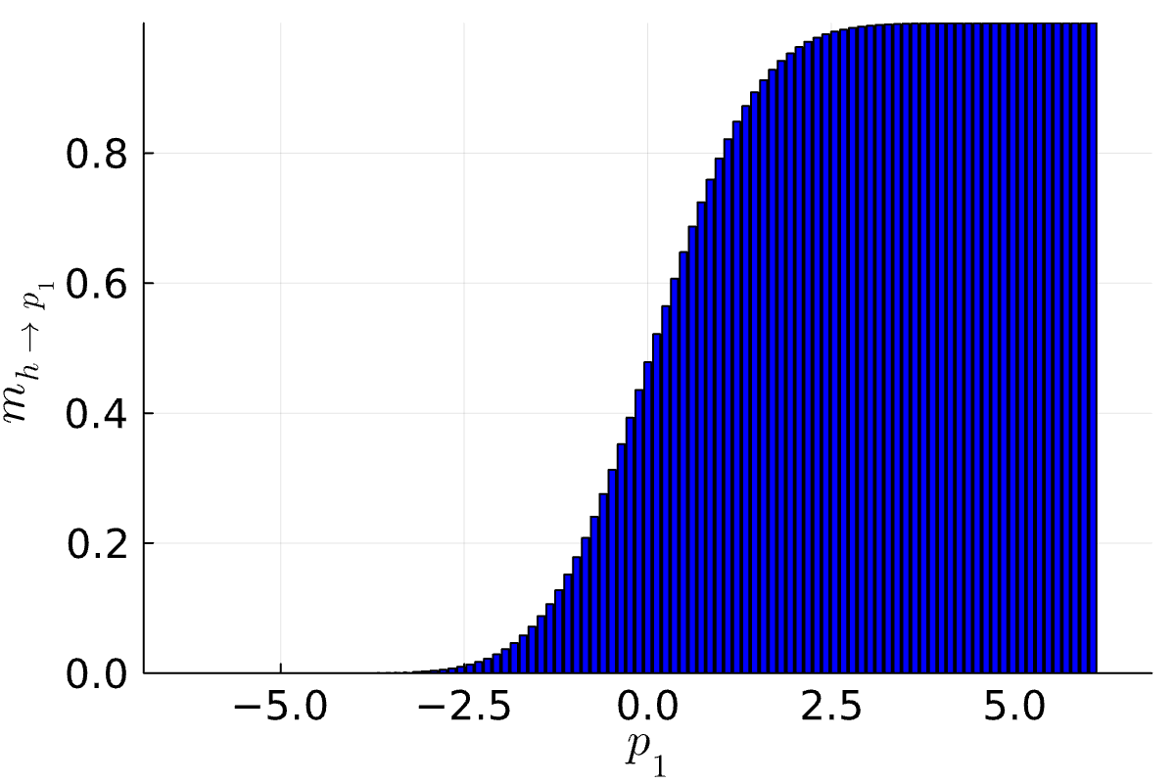
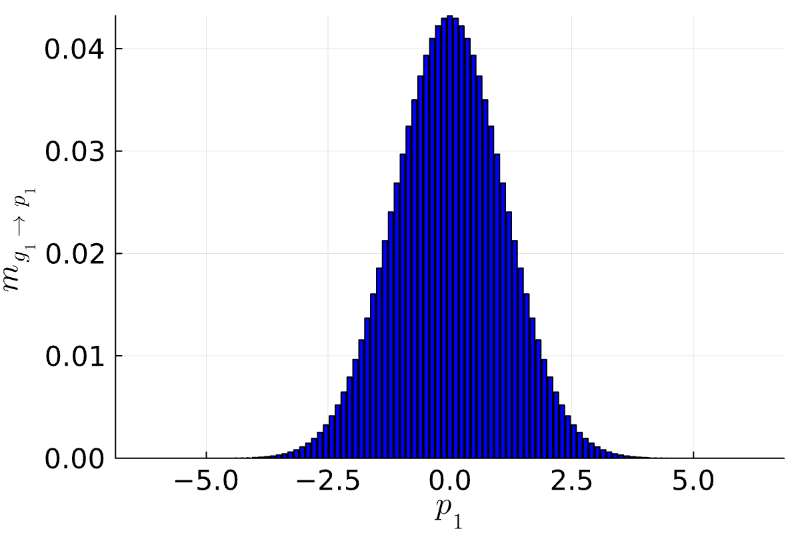
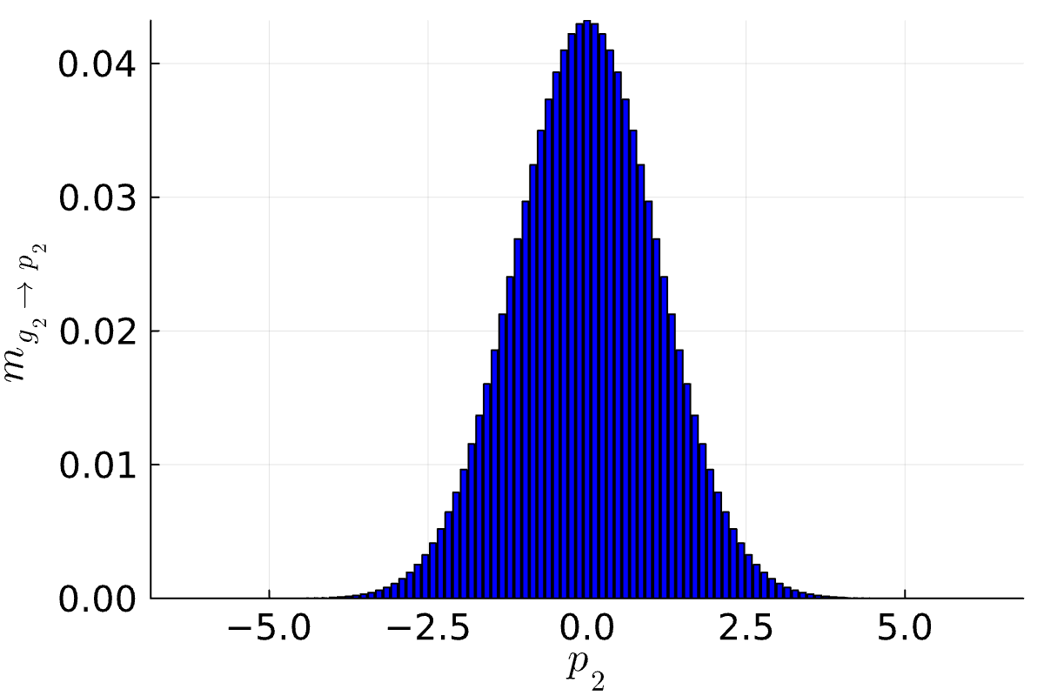
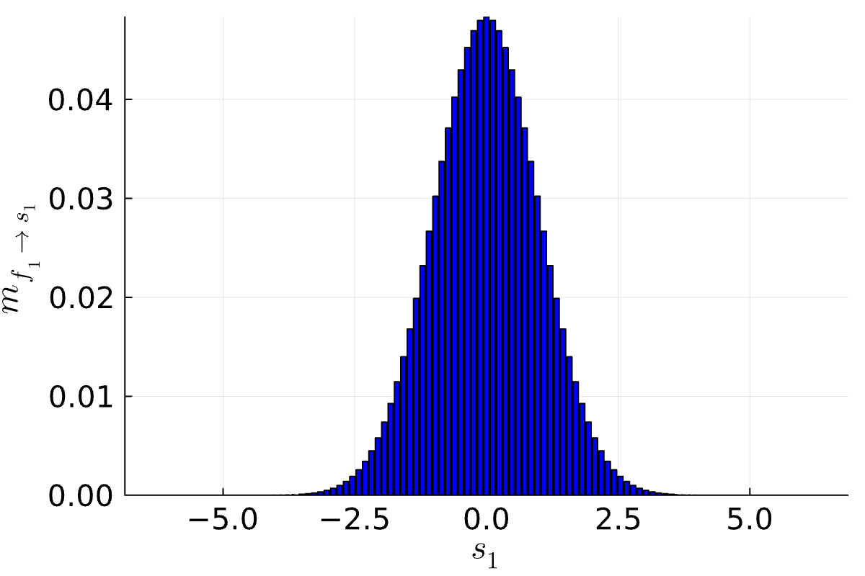

Normalization Constant via Message Passing: Example
$$𝒩\left(s_{1};μ_{1},σ_{1}^{2}\right)⋅𝒩\left(s_{2};μ_{2},σ_{2}^{2}\right)⋅𝒩\left(p_{1};s_{1},β^{2}\right)⋅𝒩\left(p_{2};s_{2},β^{2}\right)⋅𝕀\left(y\left(p_{1}−p_{2}\right)>0\right)$$
$$S_{1}$$
$$S_{2}$$
Variable node root
Factor node root
$$Z=\sum_{\left\{x_{j}\right\}}{\prod_{i∈ne\left(X_{j}\right)}{m_{f_{i}→X_{j}}\left(x_{j}\right)}}$$
$$Z=\sum_{\left\{x_{ne\left(f_{i}\right)}\right\}}{f\left(x_{ne\left(f_{i}\right)}\right)\prod_{k∈ne\left(f_{i}\right)}{m_{X_{k}→f_{i}}\left(x_{k}\right)}}$$
$$P_{1}$$
$$P_{2}$$
$$Y$$
$$P_{1}$$
$$P_{2}$$
$$P_{1}$$
$$P_{2}$$
$$S_{1}$$
$$S_{2}$$
$$S_{1}$$
$$S_{2}$$

Slide 20
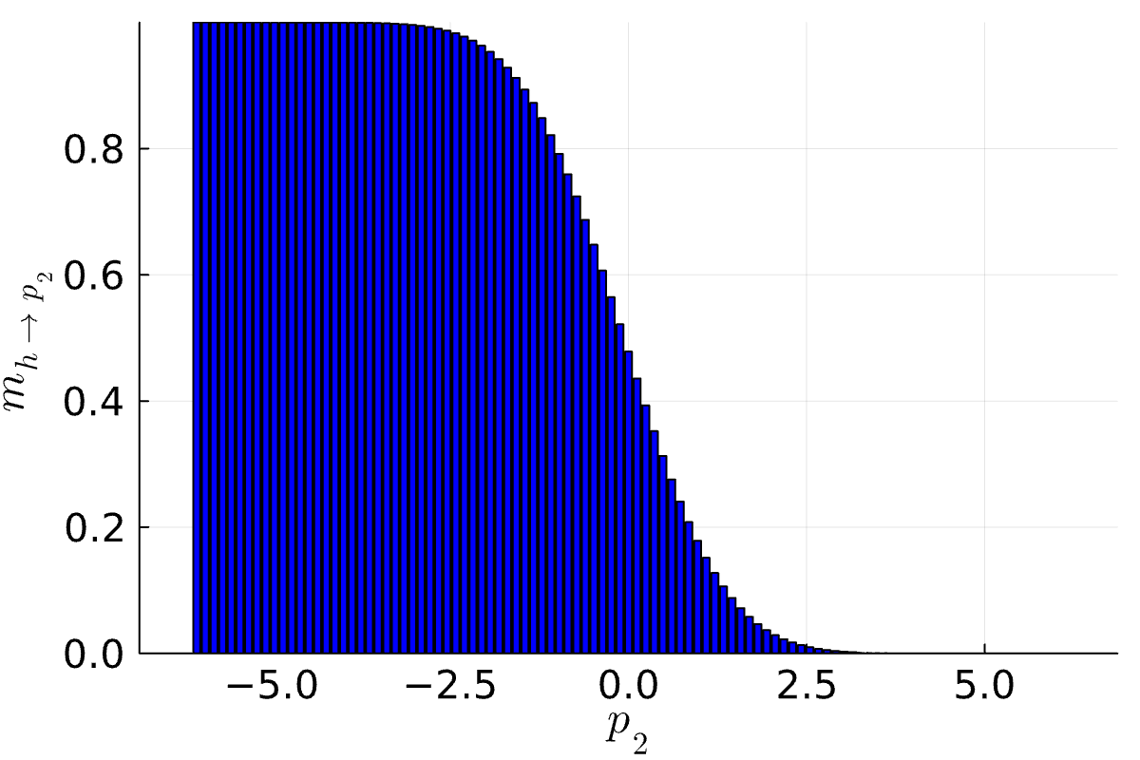
Normalization Constant via Approximate Message Passing
Challenge: Computing the normalization constant $Z$ requires
Tracking the normalization constants for all messages
Choosing a variable $X_{j}$ or factor $f_{i}$ as a root of the factor tree
Observation: Tracking the normalization constant for all messages is not always possible when approximating messages!
Theorem: Given a factor tree with renormalized messages ${\tilde{m}}_{X_{j}→f_{i}}\left(⋅\right)=β_{j,i}⋅m_{X_{j}→f_{i}}\left(⋅\right)$ and ${\tilde{m}}_{f_{i}→X_{j}}\left(⋅\right)=α_{i,j}⋅m_{f_{i}→X_{j}}\left(⋅\right)$ the normalization constant $Z$ is
$$P_{2}$$
$$P_{1}$$
$$𝕀\left(P_{1}>P_{2}\right)$$
$$Z=\left(\prod_{i=1}^{m}{Z_{f_{i}}}\right)⋅\left(\prod_{j=1}^{n}{Z_{X_{j}}}\right)$$
Factor Normalization
Variable Normalization
$$Z_{f_{i}}=\frac{\sum_{\left\{x_{ne\left(f_{i}\right)}\right\}}{f\left(x_{ne\left(f_{i}\right)}\right)\prod_{k∈ne\left(f_{i}\right)}{{\tilde{m}}_{X_{k}→f_{i}}\left(x_{k}\right)}}}{\sum_{\left\{x_{ne\left(f_{i}\right)}\right\}}{\prod_{k∈ne\left(f_{i}\right)}{{\tilde{m}}_{f_{i}→X_{k}}\left(x_{k}\right)⋅{\tilde{m}}_{X_{k}→f_{i}}\left(x_{k}\right)}}}$$
$$Z_{X_{j}}=\sum_{\left\{x_{j}\right\}}{\prod_{i∈ne\left(X_{j}\right)}{{\tilde{m}}_{f_{i}→X_{j}}\left(x_{j}\right)}}$$

Slide 21
Proof of Normalization Theorem
Simplifying the variable normalization $Z_{X_{j}}$ and factor normalization $Z_{f_{i}}$
Variable normalization
Factor normalization
$$β_{k,i}⋅m_{X_{k}→f_{i}}\left(x_{k}\right)$$
$$α_{i,j}⋅m_{f_{i}→X_{j}}\left(x_{j}\right)$$
$$Z_{X_{j}}=\sum_{\left\{x_{j}\right\}}{\prod_{i∈ne\left(X_{j}\right)}{{\tilde{m}}_{f_{i}→X_{j}}\left(x_{j}\right)}}$$
$$Z_{f_{i}}=\frac{\sum_{\left\{x_{ne\left(f_{i}\right)}\right\}}{f\left(x_{ne\left(f_{i}\right)}\right)\prod_{k∈ne\left(f_{i}\right)}{{\tilde{m}}_{X_{k}→f_{i}}\left(x_{k}\right)}}}{\sum_{\left\{x_{ne\left(f_{i}\right)}\right\}}{\prod_{k∈ne\left(f_{i}\right)}{{\tilde{m}}_{f_{i}→X_{k}}\left(x_{k}\right)⋅{\tilde{m}}_{X_{k}→f_{i}}\left(x_{k}\right)}}}$$
$$Z$$
$$Z$$
$$=\left(\prod_{i∈ne\left(X_{j}\right)}{α_{i,j}}\right)⋅\left(\sum_{\left\{x_{j}\right\}}{\prod_{i∈ne\left(X_{j}\right)}{m_{f_{i}→X_{j}}\left(x_{j}\right)}}\right)$$
$$=\frac{\left(\prod_{k∈ne\left(f_{i}\right)}{β_{k,i}}\right)⋅\left(\sum_{\left\{x_{ne\left(f_{i}\right)}\right\}}{f\left(x_{ne\left(f_{i}\right)}\right)\prod_{k∈ne\left(f_{i}\right)}{m_{X_{k}→f_{i}}\left(x_{k}\right)}}\right)}{\left(\prod_{k∈ne\left(f_{i}\right)}{β_{k,i}}\right)⋅\left(\prod_{k∈ne\left(f_{i}\right)}{α_{i,k}}\right)⋅\left(\sum_{\left\{x_{ne\left(f_{i}\right)}\right\}}{\prod_{k∈ne\left(f_{i}\right)}{m_{f_{i}→X_{k}}\left(x_{k}\right)⋅m_{X_{k}→f_{i}}\left(x_{k}\right)}}\right)}$$
$$=\left(\prod_{i∈ne\left(X_{j}\right)}{α_{i,j}}\right)⋅Z$$
$$=\frac{Z}{\left(\prod_{k∈ne\left(f_{i}\right)}{α_{i,k}}\right)⋅Z^{\left|ne\left(f_{i}\right)\right|}}$$
$$\prod_{k∈ne\left(f_{i}\right)}{\sum_{\left\{x_{k}\right\}}{m_{f_{i}→X_{k}}\left(x_{k}\right)⋅m_{X_{k}→f_{i}}\left(x_{k}\right)}}$$
$$\left(\prod_{j=1}^{n}{Z_{X_{j}}}\right)⋅\left(\prod_{i=1}^{m}{Z_{f_{i}}}\right)$$
$$=\left(\prod_{j=1}^{n}{\prod_{i∈ne\left(X_{j}\right)}{α_{i,j}}}\right)⋅Z^{n}$$
$$⋅\frac{Z^{m}}{\left(\prod_{i=1}^{m}{\prod_{k∈ne\left(f_{i}\right)}{α_{i,k}}}\right)⋅\prod_{i=1}^{m}{Z^{\left|ne\left(f_{i}\right)\right|}}}$$
$Z^{n+m−1}$ because
the factor graph
is a tree with
$n+m$ nodes!
identical

Slide 22
Overview
Distance Measures for Distributions
Approximating Marginals: Expectation Propagation
Approximating Normalization Constants
Application: Bayesian Ranking

Slide 23


The Skill Rating Problem
Given:
Match outcomes: Orderings among $k$ teams consisting of $n_{1},n_{2},…,n_{k}$ players.
Questions:
Skill $s_{i}$ for each player such that $s_{i}>s_{j}⇔P\left(Player i wins\right)>P\left(Player j wins\right)$
Global ranking among all players
Fair matches between teams of players

Slide 24

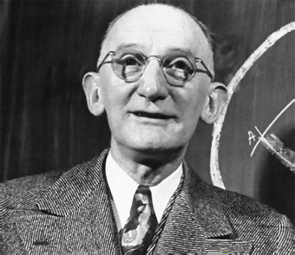
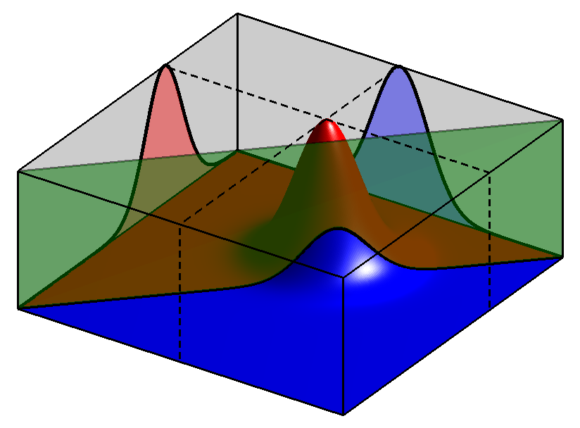




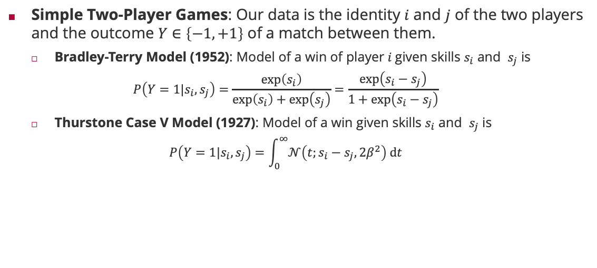




Two-Player Match Outcome Model
Simple Two-Player Games: Our data is the identity $i$ and $j$ of the two players and the outcome $Y∈\left\{−1, +1\right\}$ of a match between them.
Bradley-Terry Model (1952): Model of a win of player $i$given skills $s_{i}$ and $s_{j}$ is
$$P\left(Y=1|s_{i},s_{j}\right)=\frac{\exp\left(s_{i}\right)}{\exp\left(s_{i}\right)+\exp\left(s_{j}\right)}=\frac{\exp\left(s_{i}−s_{j}\right)}{1+\exp\left(s_{i}−s_{j}\right)}$$
Thurstone Case V Model (1927): Model of a win given skills $s_{i}$ and $s_{j}$ is
$$P\left(Y=1|s_{i},s_{j}\right)=\int_{0}^{∞}{𝒩\left(t;s_{i}−s_{j},2β^{2}\right) dt}$$
Logistic sigmoid in skill difference
Ralph A. Bradley (1923 – 2001)
Probit sigmoid in skill difference
Louis Leon Thurstone (1887 – 1955)
$$S_{1}$$
$$S_{2}$$
$$𝒩\left(P_{1};S_{1},β^{2}\right)$$
$$P_{1}$$
$$P_{2}$$
$$𝒩\left(P_{2};S_{2},β^{2}\right)$$
$$0$$
$$p_{2}$$
$$Y$$
$$p_{1}$$
$$𝕀\left(Y⋅\left(P_{1}−P_{2}\right)>0\right)$$

Slide 25










Two-Team Match Outcome Model
Team Assumption: Performance of a team is the sum of the performances of its players
Pro: Games where the team scores are additive (e.g., kill count in first-person shooter)
Con: Games where the outcome is determined by a single player (e.g., fastest car in a race)
Observation: Match outcomes correlate the skills of players
Same Team: Anti-correlated
Opposite Teams: Correlated
$$S_{1}$$
$$S_{2}$$
$$S_{3}$$
$$S_{4}$$
$$𝒩\left(T_{1};S_{1}+S_{2},{2β}^{2}\right)$$
$$T_{1}$$
$$T_{2}$$
$$𝒩\left(T_{2};S_{3}+S_{4},2β^{2}\right)$$
$$Y$$
$$𝕀\left(Y⋅\left(T_{1}−T_{2}\right)>0\right)$$

Slide 26













Multi-Team Match Outcome Model
Possible Outcomes: Permutations $Y∈{\left\{1,2,3\right\}}^{3}$ of teams
Easy to sample for given skills but computationally difficult to ”invert”!
$$S_{1}$$
$$S_{2}$$
$$S_{3}$$
$$S_{4}$$
$$𝒩\left(T_{1};S_{1},β^{2}\right)$$
$$T_{1}$$
$$𝒩\left(T_{2};S_{2}+S_{3},{2β}^{2}\right)$$
$$T_{2}$$
$$T_{3}$$
$$𝒩\left(T_{3}; S_{4},β^{2}\right)$$
$$Y$$
Total number of outcomes: $3!$
$$𝕀\left(Y=\left(i,j,k\right) if T_{i}>T_{j}>T_{k}\right)$$

Slide 27















From Match Outcomes to Pairwise Rankings
Learning: In the ranking setting, we observe multi-team match outcomes and want to infer the skills of all single players!
Idea: Leverage the transitivity of the real line of latent scores!
$$S_{1}$$
$$S_{2}$$
$$S_{3}$$
$$S_{4}$$
$$𝒩\left(T_{1};S_{1},β^{2}\right)$$
$$T_{1}$$
$$𝒩\left(T_{2};S_{2}+S_{3},{2β}^{2}\right)$$
$$T_{2}$$
$$T_{3}$$
$$𝒩\left(T_{3}; S_{4},β^{2}\right)$$
$$Y_{1,2}$$
$$Y_{2,3}$$
$$𝕀\left(Y_{1,2}=+1\right)$$
$$𝕀\left(Y_{2,3}=+1\right)$$
By transitivity, this implies $T_{1}>T_{3}$

Slide 28

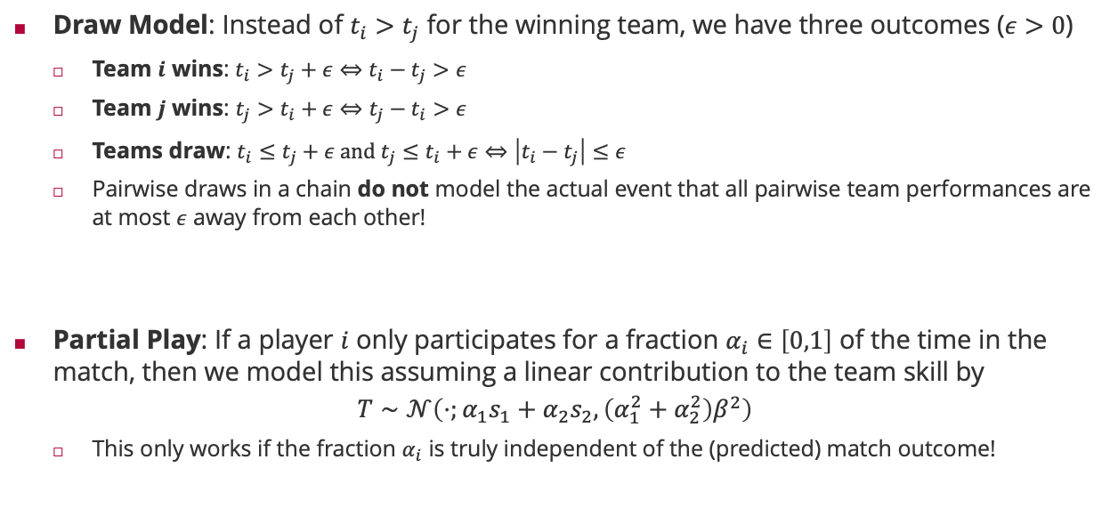



Modelling Draws and Partial Play
Draw Model: Instead of $t_{i}>t_{j}$ for the winning team, we have three outcomes ($ε>0$)
Team $i$ wins: $t_{i}>t_{j}+ε⇔t_{i}−t_{j}>ε$
Team $j$ wins: $t_{j}>t_{i}+ε⇔t_{j}−t_{i}>ε$
Teams draw: $t_{i}≤t_{j}+ε and t_{j}≤t_{i}+ε⇔\left|t_{i}−t_{j}\right|≤ε$
Pairwise draws in a chain do not model the actual event that all pairwise team performances are at most $ε$ away from each other!
Partial Play: If a player $i$ only participates for a fraction $α_{i}∈\left[0,1\right]$ of the time in the match, then we model this assuming a linear contribution to the team skill by
$$T∼𝒩\left(⋅;{α_{1}s}_{1}+α_{2}s_{2},{\left(α_{1}^{2}+α_{2}^{2}\right)β}^{2}\right)$$
This only works if the fraction $α_{i}$ is truly independent of the (predicted) match outcome!
$$t_{k}$$
$$t_{j}$$
$$t_{i}$$
Draw margin of $2ε$ for $t_{i}$

Slide 29


























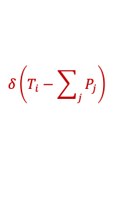
TrueSkill Factor Tree
Bayesian Network
Factor Graph
$$S_{1}$$
$$S_{2}$$
$$S_{3}$$
$$S_{4}$$
$$𝒩\left(S_{i};μ_{i},σ_{i}^{2}\right)$$
$$T_{1}$$
$$T_{2}$$
$$T_{3}$$
$$S_{1}$$
$$S_{2}$$
$$S_{3}$$
$$S_{4}$$
$$𝒩\left(P_{i};S_{i},β^{2}\right)$$
$$Y_{1,2}$$
$$Y_{2,3}$$
$$P_{1}$$
$$P_{2}$$
$$P_{3}$$
$$P_{4}$$
$$δ\left(T_{i}−\sum_{j}{P_{j}}\right)$$
$$T_{1}$$
$$T_{2}$$
$$T_{3}$$
$$δ\left(D_{i,j}−\left(T_{i}−T_{j}\right)\right)$$
$$D_{1,2}$$
$$D_{2,3}$$
$$𝕀\left(D_{i,j}>0\right)$$

Slide 30






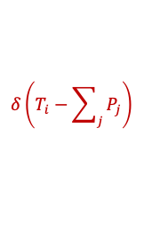











(Approximate) Message Passing in TrueSkill Factor Trees
TrueSkill Factor Graph
Four Phases
Pass prior messages (1)
Pass messages down to the team performances (2 to 3)
Iterate the approximate messages on the pairwise team differences (4 to 9)
Pass messages back from up from team performances to player skill (10 – 12)
Since this is a tree, the algorithm is guaranteed to converge!
$$𝒩\left(S_{i};μ_{i},σ_{i}^{2}\right)$$
1
1
1
1
$$S_{1}$$
$$S_{2}$$
$$S_{3}$$
$$S_{4}$$
12
12
12
12
$$𝒩\left(P_{i};S_{i},β^{2}\right)$$
2
2
2
2
$$P_{1}$$
$$P_{2}$$
$$P_{3}$$
$$P_{4}$$
11
11
$$δ\left(T_{i}−\sum_{j}{P_{j}}\right)$$
11
11
3
3
3
$$T_{1}$$
$$T_{2}$$
$$T_{3}$$
$$δ\left(D_{i,j}−\left(T_{i}−T_{j}\right)\right)$$
10
6
9
10
4
7
$$D_{1,2}$$
$$D_{2,3}$$
5
8
$$𝕀\left(D_{i,j}>0\right)$$

Slide 31




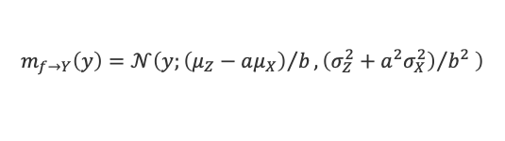



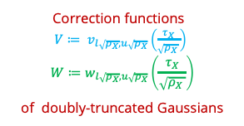





















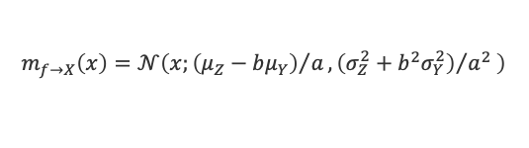

Message Update Equations
Gaussian Factor $𝒩\left(X;μ,σ^{2}\right)$
Gaussian Mean Factor $𝒩\left(Y;X,β^{2}\right)$
$$m_{f→X}\left(⋅\right)$$
$$𝒩\left(⋅;μ_{X},σ_{X}^{2}\right)$$
$$m_{f→Y}\left(⋅\right)$$
$$X$$
$$X$$
$$Y$$
$$m_{f→X}\left(⋅\right)$$
$$𝒩\left(⋅;μ_{Y},σ_{Y}^{2}\right)$$
$$m_{f→X}\left(x\right)=𝒩\left(x;μ,σ^{2}\right)$$
$$m_{f→Y}\left(y\right)=𝒩\left(y;μ_{X},σ_{X}^{2}+β^{2}\right)$$
$$m_{f→X}\left(x\right)=𝒩\left(x;μ_{Y},σ_{Y}^{2}+β^{2}\right)$$
Correction functions $V≔ v_{l\sqrt{ρ_{X}},u\sqrt{ρ_{X}}}\left(\frac{τ_{X}}{\sqrt{ρ_{X} }}\right)$ $$W≔w_{l\sqrt{ρ_{X}},u\sqrt{ρ_{X}}}\left(\frac{τ_{X}}{\sqrt{ρ_{X} }}\right)$$
of doubly-truncated Gaussians
Weighted Sum Factor $δ\left(Z−\left(aX+bY\right)\right)$
Between Factor $𝕀\left(l≤X<u\right)$
$$X$$
$$m_{f→Y}\left(⋅\right)$$
$$m_{f→X}\left(⋅\right)$$
$$Y$$
$$𝒩\left(⋅;μ_{X},σ_{X}^{2}\right)$$
$$𝒩\left(⋅;μ_{Y},σ_{Y}^{2}\right)$$
$${\hat{m}}_{f→X}\left(⋅\right)$$
$$X$$
$$𝒩\left(⋅;μ_{Z},σ_{Z}^{2}\right)$$
$$m_{f→Z}\left(⋅\right)$$
$$𝒢\left(⋅;τ_{X},ρ_{X}\right)$$
$$Z$$
$$m_{f→Z}\left(z\right)=𝒩\left(z;aμ_{X}+bμ_{Y},a^{2}σ_{X}^{2}+b^{2}σ_{Y}^{2}\right)$$
$${\hat{m}}_{f→X}\left(x\right)=𝒢\left(x;\sqrt{ρ_{X}}⋅\frac{V}{1−W}+τ_{X}⋅\frac{W}{1−W},ρ_{X}⋅\frac{W}{1−W}\right)$$
$$m_{f→Y}\left(y\right)=𝒩\left(y;{\left(μ_{Z}−aμ_{X}\right)}/b,{\left(σ_{Z}^{2}+a^{2}σ_{X}^{2}\right)}/{b^{2}} \right)$$
$$m_{f→X}\left(x\right)=𝒩\left(x;{\left(μ_{Z}−bμ_{Y}\right)}/a,{\left(σ_{Z}^{2}+b^{2}σ_{Y}^{2}\right)}/{a^{2}} \right)$$

Slide 32

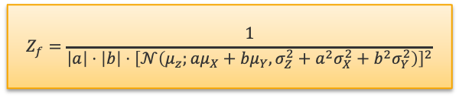

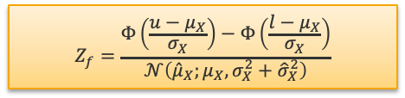
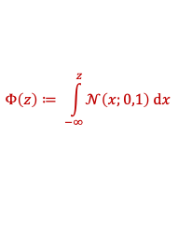


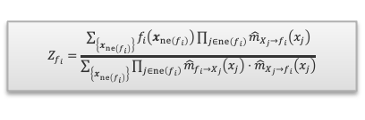
Factor Normalizations
Gaussian Factor $𝒩\left(X;μ,σ^{2}\right)$
Gaussian Mean Factor $𝒩\left(Y;X,β^{2}\right)$
$$Z_{f_{i}}=\frac{\sum_{\left\{x_{ne\left(f_{i}\right)}\right\}}{f_{i}\left(x_{ne\left(f_{i}\right)}\right)\prod_{j∈ne\left(f_{i}\right)}{{\hat{m}}_{X_{j}→f_{i}}\left(x_{j}\right)}}}{\sum_{\left\{x_{ne\left(f_{i}\right)}\right\}}{\prod_{j∈ne\left(f_{i}\right)}{{\hat{m}}_{f_{i}→X_{j}}\left(x_{j}\right)}⋅{\hat{m}}_{X_{j}→f_{i}}\left(x_{j}\right)}}$$
$$𝒩\left(⋅;μ_{X},σ_{X}^{2}\right)$$
$$X$$
$$X$$
$$Y$$
$$𝒩\left(⋅;μ_{Y},σ_{Y}^{2}\right)$$
$$Z_{f}=1$$
$$Z_{f}=\frac{1}{𝒩\left(μ_{X};μ_{Y},σ_{X}^{2}+σ_{Y}^{2}+β^{2}\right)}$$
Weighted Sum Factor $δ\left(Z−\left(aX+bY\right)\right)$
Between Factor $𝕀\left(l≤X<u\right)$
$$X$$
$$Y$$
$$𝒩\left(⋅;μ_{X},σ_{X}^{2}\right)$$
$$𝒩\left(⋅;μ_{Y},σ_{Y}^{2}\right)$$
$$𝒩\left(⋅;{\hat{μ}}_{X},{\hat{σ}}_{X}^{2}\right)$$
$$X$$
$$𝒩\left(⋅;μ_{Z},σ_{Z}^{2}\right)$$
$$Φ\left(z\right)≔ \int_{−∞}^{z}{𝒩\left(x;0,1\right) dx}$$
$$𝒩\left(⋅;μ_{X},σ_{X}^{2}\right)$$
$$Z$$
$$Z_{f}=\frac{1}{\left|a\right|⋅\left|b\right|⋅{\left[𝒩\left(μ_{z};{aμ}_{X}+bμ_{Y},σ_{Z}^{2}+{a^{2}σ}_{X}^{2}+b^{2}σ_{Y}^{2}\right)\right]}^{2}}$$
$$Z_{f}=\frac{Φ\left(\frac{u−μ_{X}}{σ_{X}}\right)−Φ\left(\frac{l−μ_{X}}{σ_{X}}\right)}{𝒩\left({\hat{μ}}_{X};μ_{X},σ_{X}^{2}+{\hat{σ}}_{X}^{2}\right)}$$

Slide 33
















Skill Dynamics
Dynamics: In reality, skills of players evolve over time and are not stationary
Idea: Since we do not know which direction the skills evolve, assume that the skill of player $i$ at time $t$ depends on the skill of the same player at time $t−1$ via
$$S_{i,t}∼𝒩\left(S_{i,t};S_{i,t−1},γ^{2}\right)$$
$$S_{1,1}$$
$$S_{1,2}$$
$$S_{1,3}$$
$$P_{1,1}$$
$$P_{1,2}$$
$$P_{1,3}$$
$$D_{1,2}^{(1)}$$
$$D_{1,2}^{(2)}$$
$$D_{1,2}^{(3)}$$
$$P_{2,1}$$
$$P_{2,2}$$
$$P_{2,3}$$
$$S_{2,1}$$
$$S_{2,2}$$
$$S_{2,3}$$

Slide 34





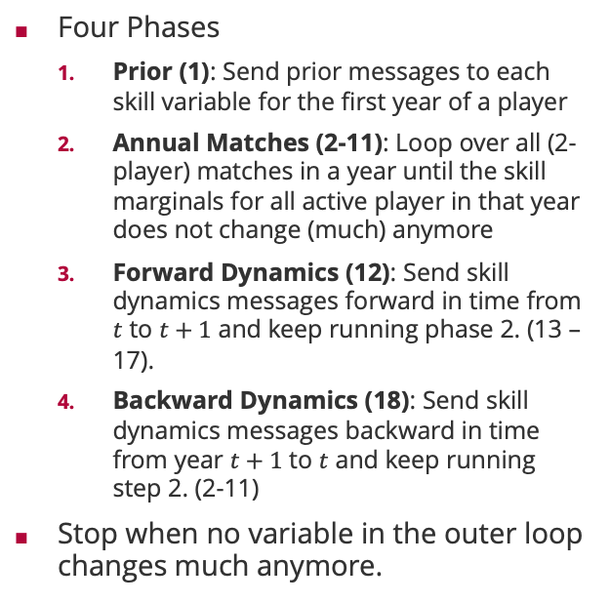








TrueSkill Through Time: Message Schedule
Performance of player 1 in year 1 in second match
Four Phases
Prior (1): Send prior messages to each skill variable for the first year of a player
Annual Matches (2-11): Loop over all (2-player) matches in a year until the skill marginals for all active player in that year does not change (much) anymore
Forward Dynamics (12): Send skill dynamics messages forward in time from $t$ to $t+1$ and keep running phase 2. (13 – 17).
Backward Dynamics (18): Send skill dynamics messages backward in time from year $t+1$ to $t$ and keep running step 2. (2-11)
Stop when no variable in the outer loop changes much anymore.
1
$$S_{1,1}$$
18
12
$$S_{1,2}$$
6
11
17
2
7
13
$$P_{1,1,1}$$
$$P_{1,1,2}$$
$$P_{1,2,1}$$
5
10
16
4
$$D_{1,2,1}^{(1)}$$
3
9
$$D_{1,2,2}^{(1)}$$
8
15
$$D_{1,2,1}^{(2)}$$
14
5
10
16
$$P_{2,1,2}$$
$$P_{2,1,2}$$
$$P_{2,2,1}$$
2
7
13
6
11
17
1
$$S_{2,1}$$
18
12
$$S_{2,2}$$
Year 1
Year 2

Slide 35
TrueSkill-Through-Time: Chess Players
Garry Kasparov
3000
2800
Robert James Fischer
Anatoly Karpov
2600
Mikhail Botvinnik
History of Chess 3.5M match outcomes 20 million variables
40 million factors
2400
Paul Morphy
Skill estimate
Whilhelm Steinitz
2200
Boris V Spassky
2000
Emanuel Lasker
1800
Jose Raul Capablanca
1600
Adolf Anderssen
1400
1850
1858
1866
1875
1883
1891
1899
1907
1916
1924
1932
1940
1949
1957
1965
1973
1981
1990
1998
2006
Year

Slide 36
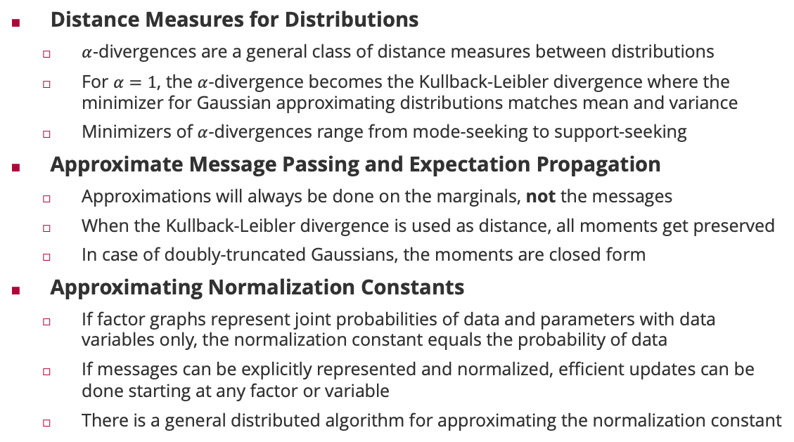
Summary
Distance Measures for Distributions
$α$-divergences are a general class of distance measures between distributions
For $α=1$, the $α$-divergence becomes the Kullback-Leibler divergence where the minimizer for Gaussian approximating distributions matches mean and variance
Minimizers of $α$-divergences range from mode-seeking to support-seeking
Approximate Message Passing and Expectation Propagation
Approximations will always be done on the marginals, not the messages
When the Kullback-Leibler divergence is used as distance, all moments get preserved
In case of doubly-truncated Gaussians, the moments are closed form
Approximating Normalization Constants
If factor graphs represent joint probabilities of data and parameters with data variables only, the normalization constant equals the probability of data
If messages can be explicitly represented and normalized, efficient updates can be done starting at any factor or variable
There is a general distributed algorithm for approximating the normalization constant

Slide 37
See you next week!

